Slide 1

STRUCTURED QUERY LANGUAGE

Slide 2
Database & Database Management System
A database is a systematic collection of data. They support electronic storage and manipulation of data. Databases make data management easy.
Database Management System (DBMS) is a collection of programs which enables its users to access database, manipulate data, reporting and representation of data. It also helps to control access to the database. Database Management Systems are not a new concept and as such, had been first implemented in the 1960s.

Slide 3
SQL
SQL (Structured Query Language) is used to perform operations on the records stored in database such as updating records, deleting records, creating and modifying tables, views etc.
SQL is used
To create new databases, tables and views
To insert records in a database
To update records in a database
To delete records from a database
To retrieve data from a database

Slide 4
Types of DBMS:
Hierarchical: This type of DBMS employs the "parent-child" relationship of storing data. This type of DBMS is rarely used nowadays. Its structure is like a tree with nodes representing records and branches representing fields. The windows registry used in Windows XP is an example of a hierarchical database. Configuration settings are stored as tree structures with nodes.
Network DBMS: This type of DBMS supports many-to-many relations. It usually results in complex database structures. RDM Server is an example of a database management system that implements the network model

Slide 5
Relational DBMS: This type of DBMS defines database relationships in the form of tables, also known as relations. Unlike network DBMS, RDBMS does not support many to many relationships. Relational DBMS usually have pre-defined data types that they can support. It is the most popular DBMS type in the market. Examples of relational database management systems include MySQL, Oracle, and Microsoft SQL Server database.
Object-Oriented Relation DBMS: This type supports the storage of new data types. The data to be stored is in the form of objects. The objects to be stored in the database have attributes (i.e., gender, ager) and methods that define what to do with the data. PostgreSQL is an example of an object-oriented relational DBMS.

Slide 6
Database creation to deletion:
CREATE DATABASE database_name;
USE DATABASE database_name;
RENAME DATABASE oldname TO newname;
ALTER DATABASE old_name MODIFY NAME = new_name
DROP DATABASE database_name;

Slide 7
Creating a table:
create table tablename(column1 data type, column2 data type, column3 data type, …,columnN data type);
Inserting elements in table:
1.Insert into tablename values (value1, value2, value 3, .... Value N);
2.Insert into tablename[(col1, col2, col3,.... col N)] values (value1, value2, value 3, .... Value N);

Slide 8

Updating a table:
Update table_name set [column_name1= value1,..column_nameN = valueN] [where condition]
Retrieving the data or table:
1.Select (expression) from table_name;
2.Select count (expression) from table_name;
3.Select count(column) from table_name;
4.Select distinct(column) from table_name;

Slide 9
5.SELECT SUM (expression) FROM tables WHERE conditions;
Renaming the table name:
Alter table table_name rename to new_table_name;
Copying from one table to another:
Select * into <destination_table> from <source_table>

Slide 10
Deleting a table or elements:
truncate table table_name;
drop table "table_name";
delete from table_name;
delete from table_name [where condition];

Slide 11
Trigger:
Trigger is invoked by Oracle engine automatically whenever a specified event occurs. Trigger is stored into database and invoked repeatedly, when specific condition match.
Cursor:
When an SQL statement is processed, Oracle creates a memory area known as context area. A cursor is a pointer to this context area. It contains all information needed for processing the statement. The context area is controlled by Cursor.

Slide 12
JDBC:
JDBC stands for Java Database Connectivity, which is a standard Java API for database-independent connectivity between the Java programming language and a wide range of databases.
The JDBC library includes APIs for each of the tasks mentioned below that are commonly associated with database usage.
Making a connection to a database.
Creating SQL or MySQL statements.
Executing SQL or MySQL queries in the database.
Viewing & Modifying the resulting records.

Slide 13
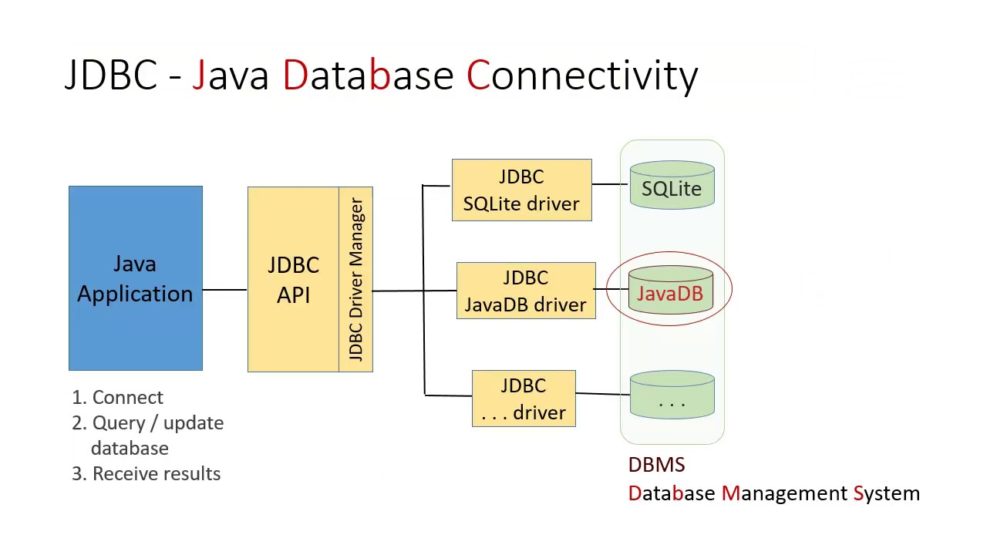
JDBC driver:

Slide 14
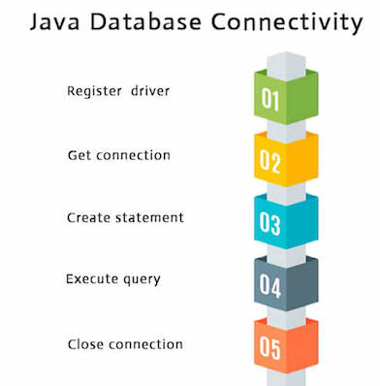
JDBC connection process:

